Slide 1



Final Presentation
Team 32: Abhi Singh, Holden Haile, Kelton Chesshire Sponsor: Eric Lloyd Robles TA: Eric Lloyd Robles
Notes:
Michelle

Slide 2
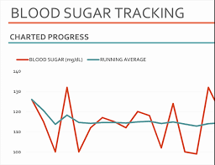
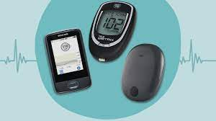
Problem Statement
In the U.S. Alone over 10% of the population suffers from Diabetes
Type 1 diabetes requires monitoring of blood sugar levels 4-10 times a day
The process can become a guess and check game with inconsistent data and little comfort for the user

Slide 3
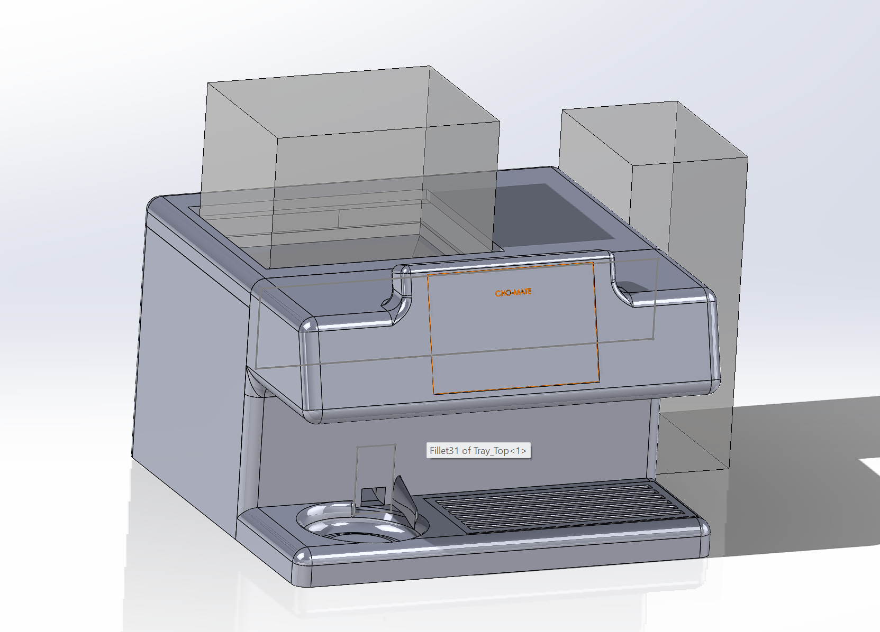
Solution Proposal
Dispense carbohydrates in a consistent, accurate, and easily-consumable manner
Provide the user with information regarding their personal blood sugar patterns
Portable and easy to refill

Slide 4
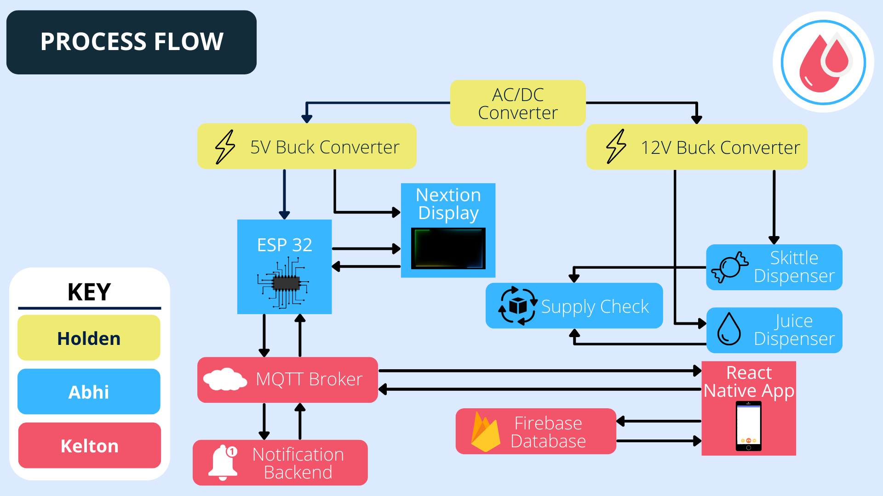
System Flow Chart

Slide 5
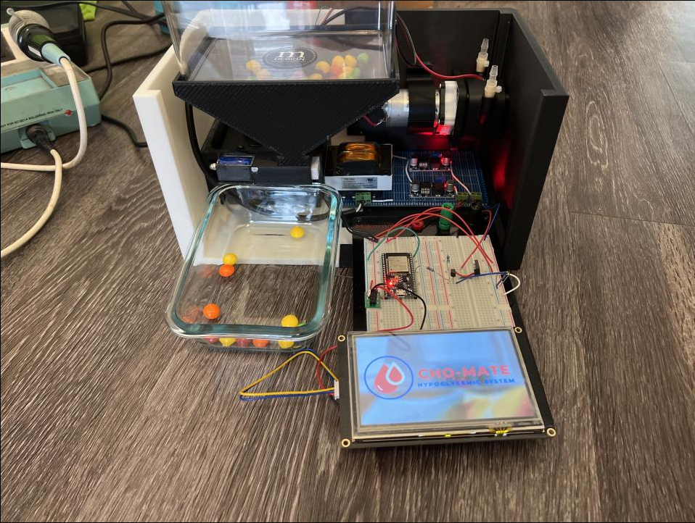
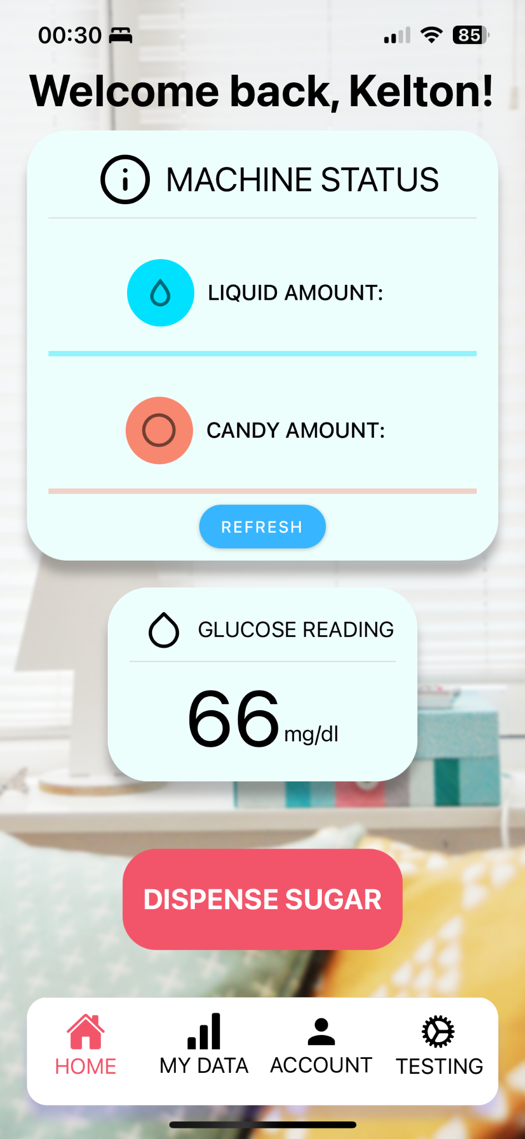
Real System Overview
Juice Pump
Skittle Dispenser
Power Supply
Microcontroller
Nextion Display

Slide 6
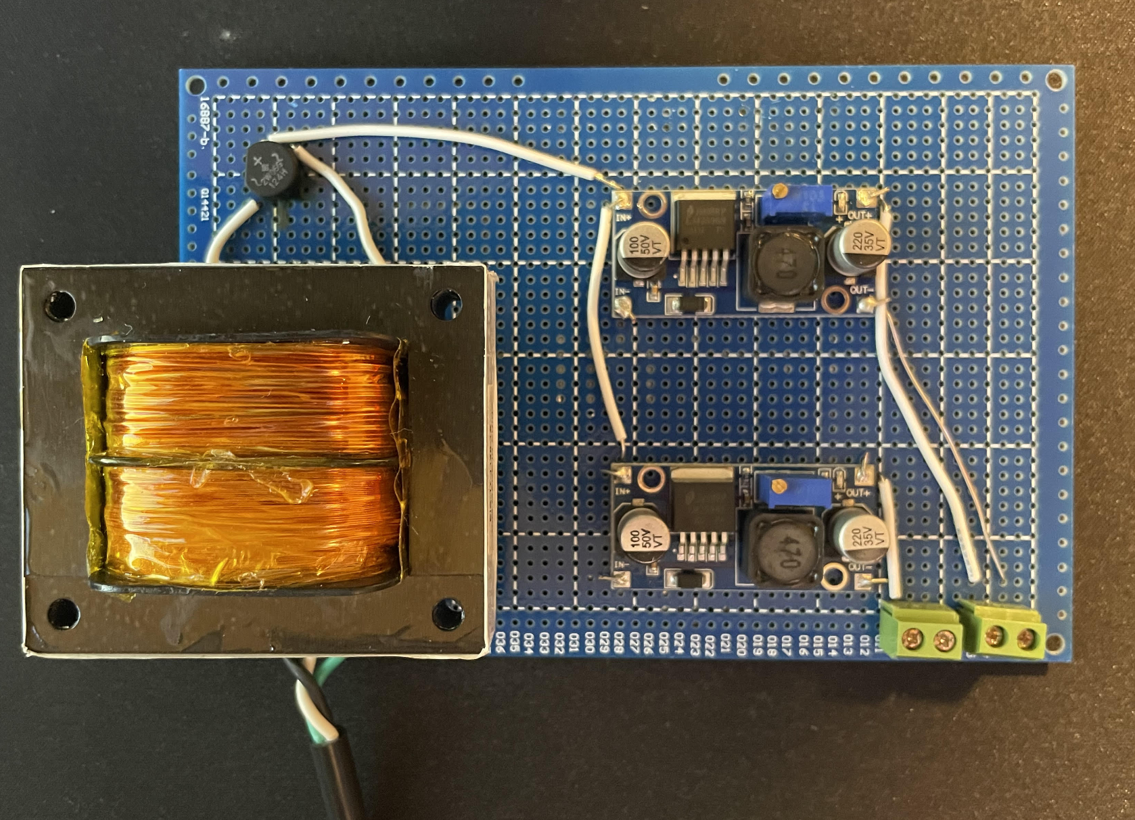
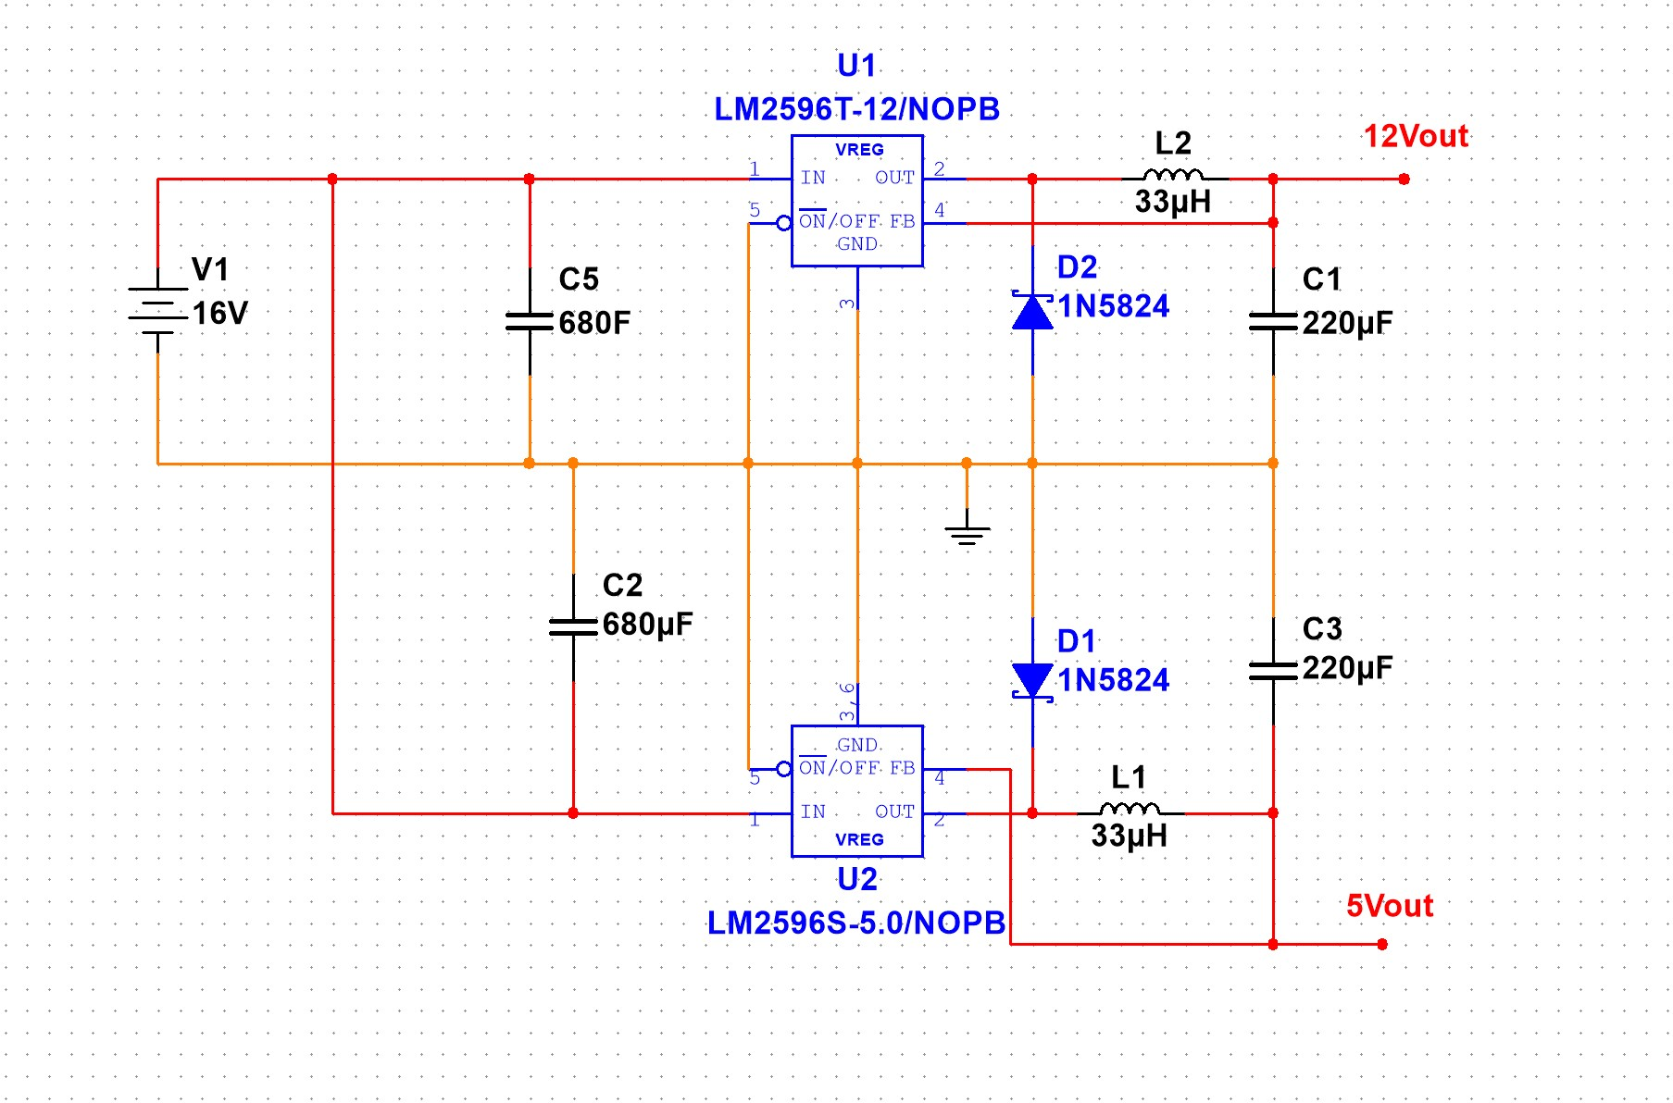
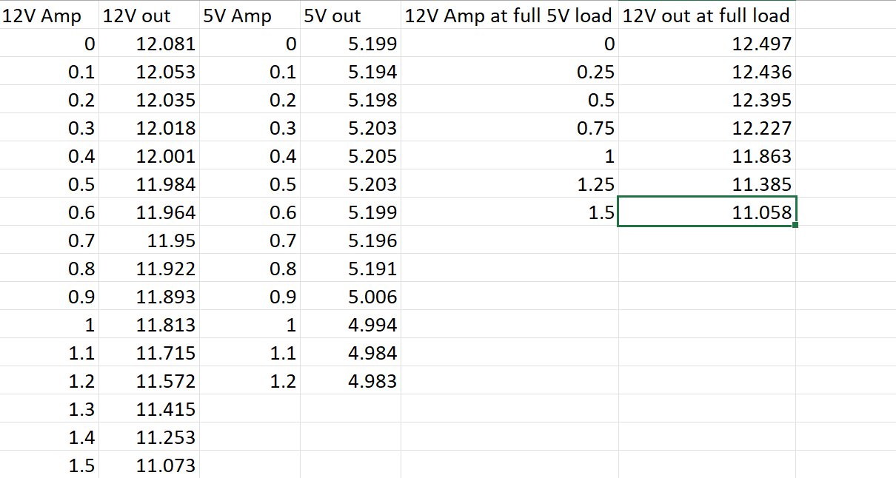
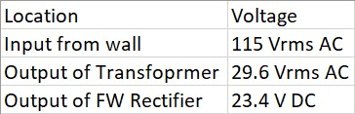
Power Supply Design - Holden Haile
Validation
Slight voltage drop on the 12V buck but nothing that will cause any issues in our system

Slide 7
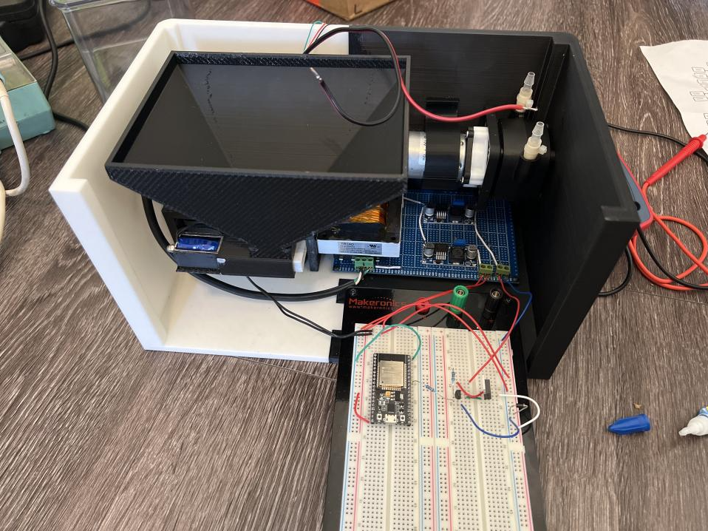
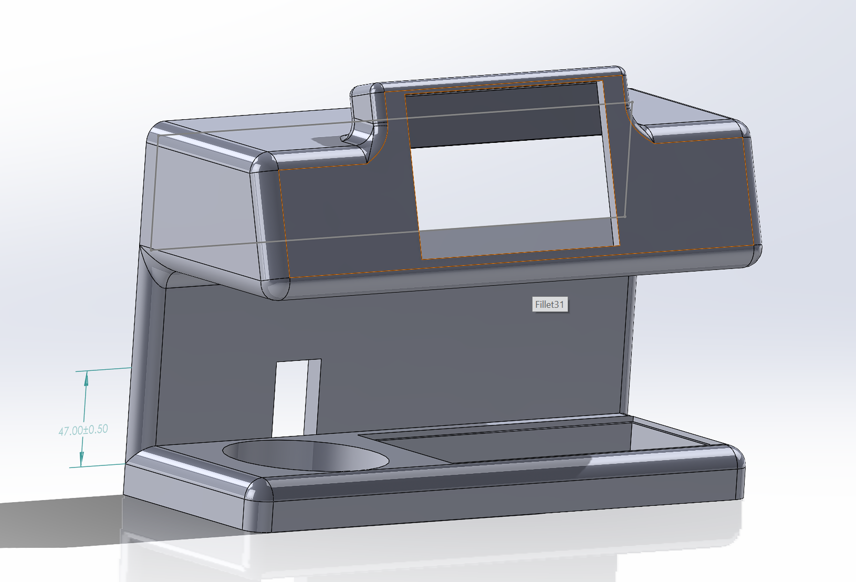
Housing Design - Holden and Abhi

Slide 8
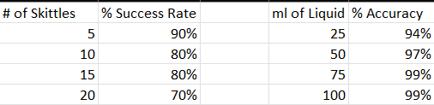
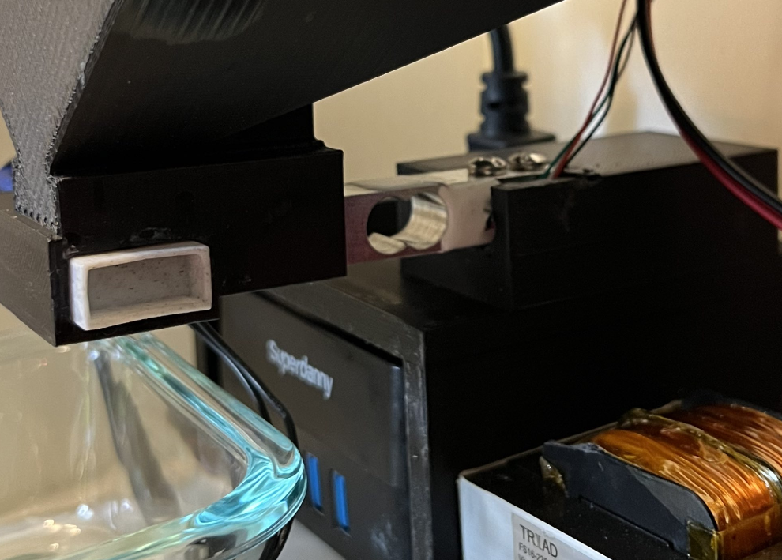
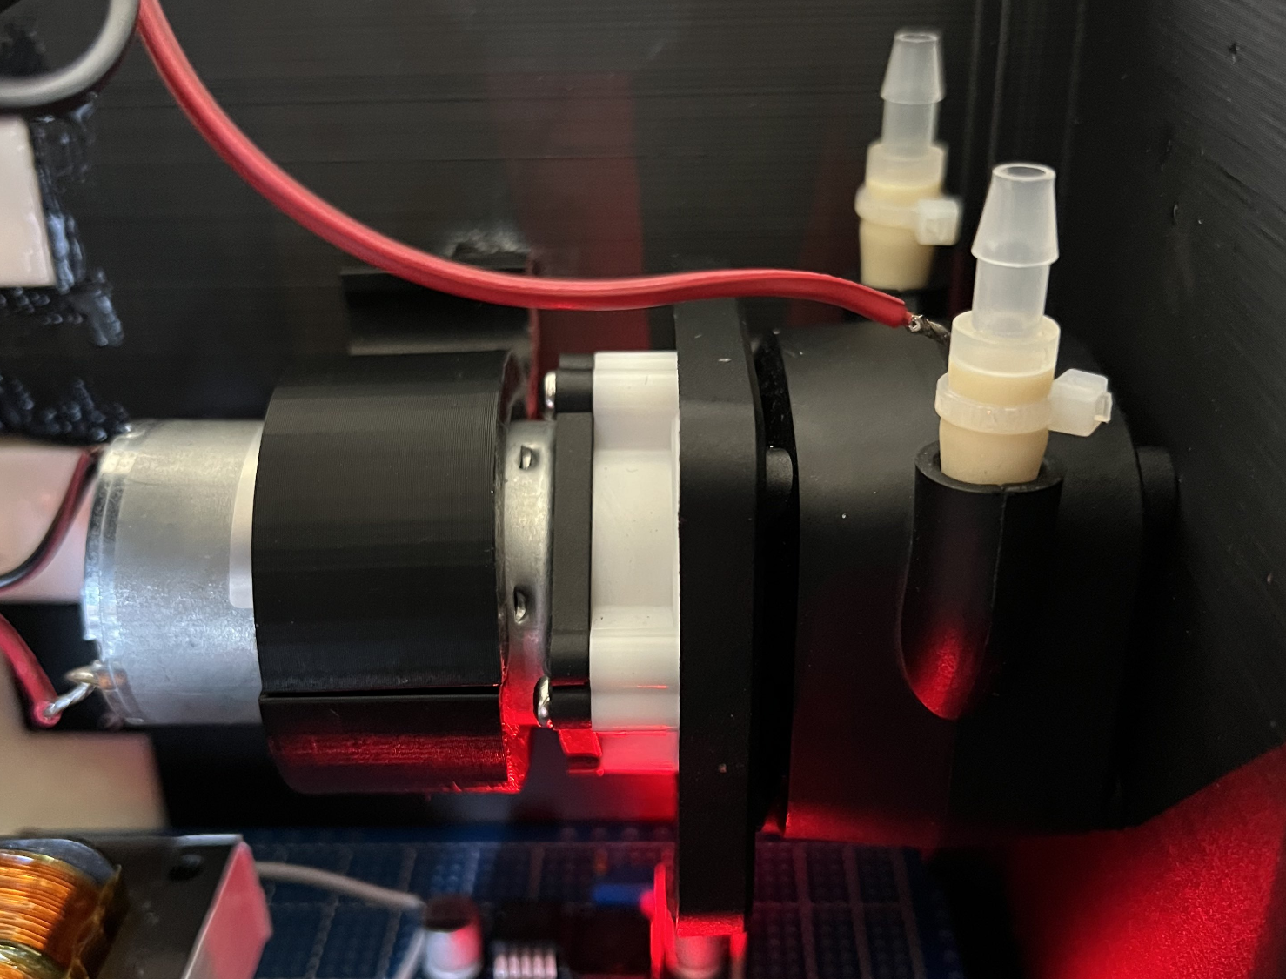
Dispenser - Abhi Singh
Data taken from 10 attempts for each dispensing amount

Slide 9
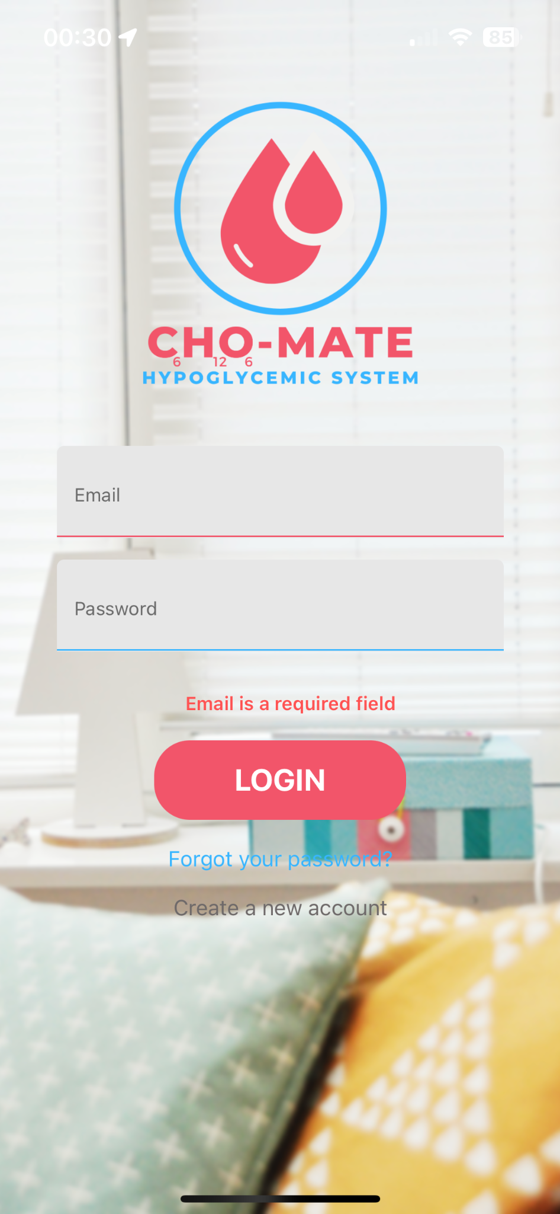
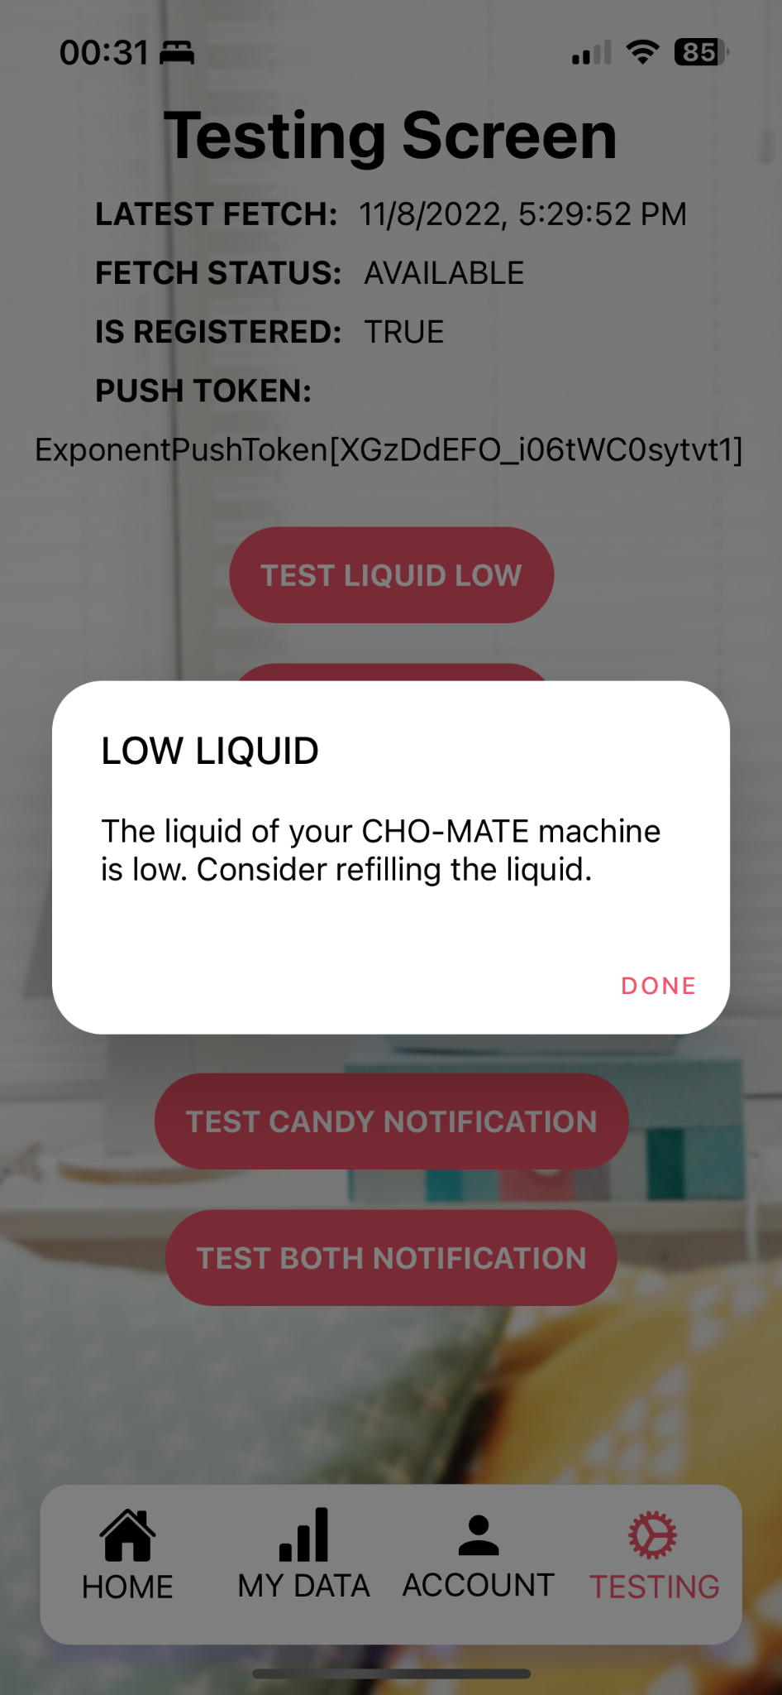
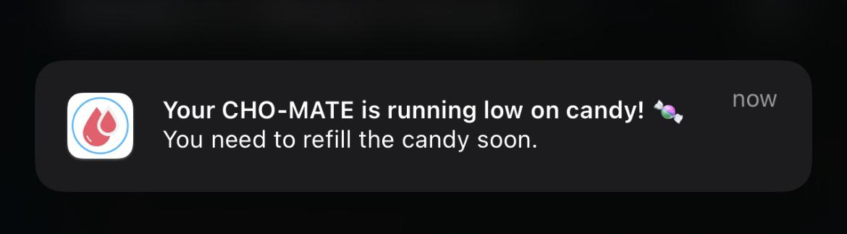
Application - Kelton Chesshire

Slide 10
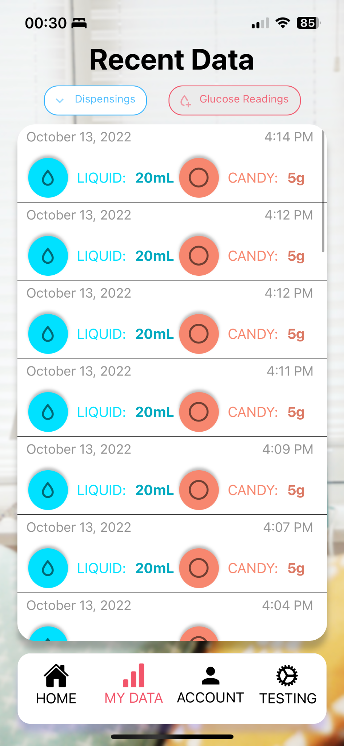
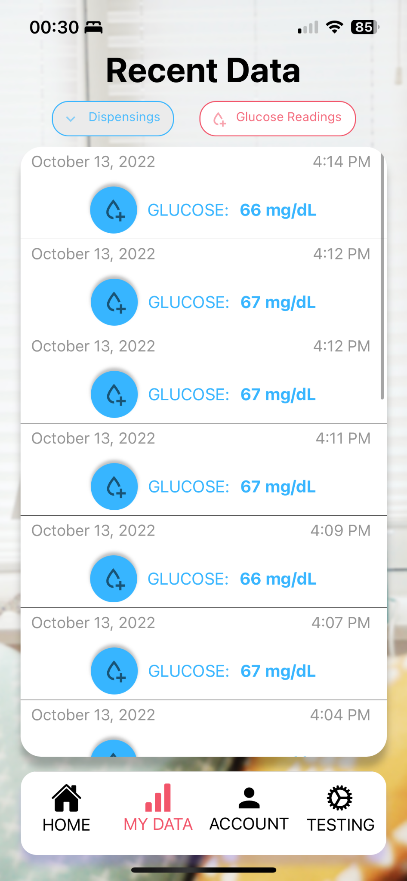
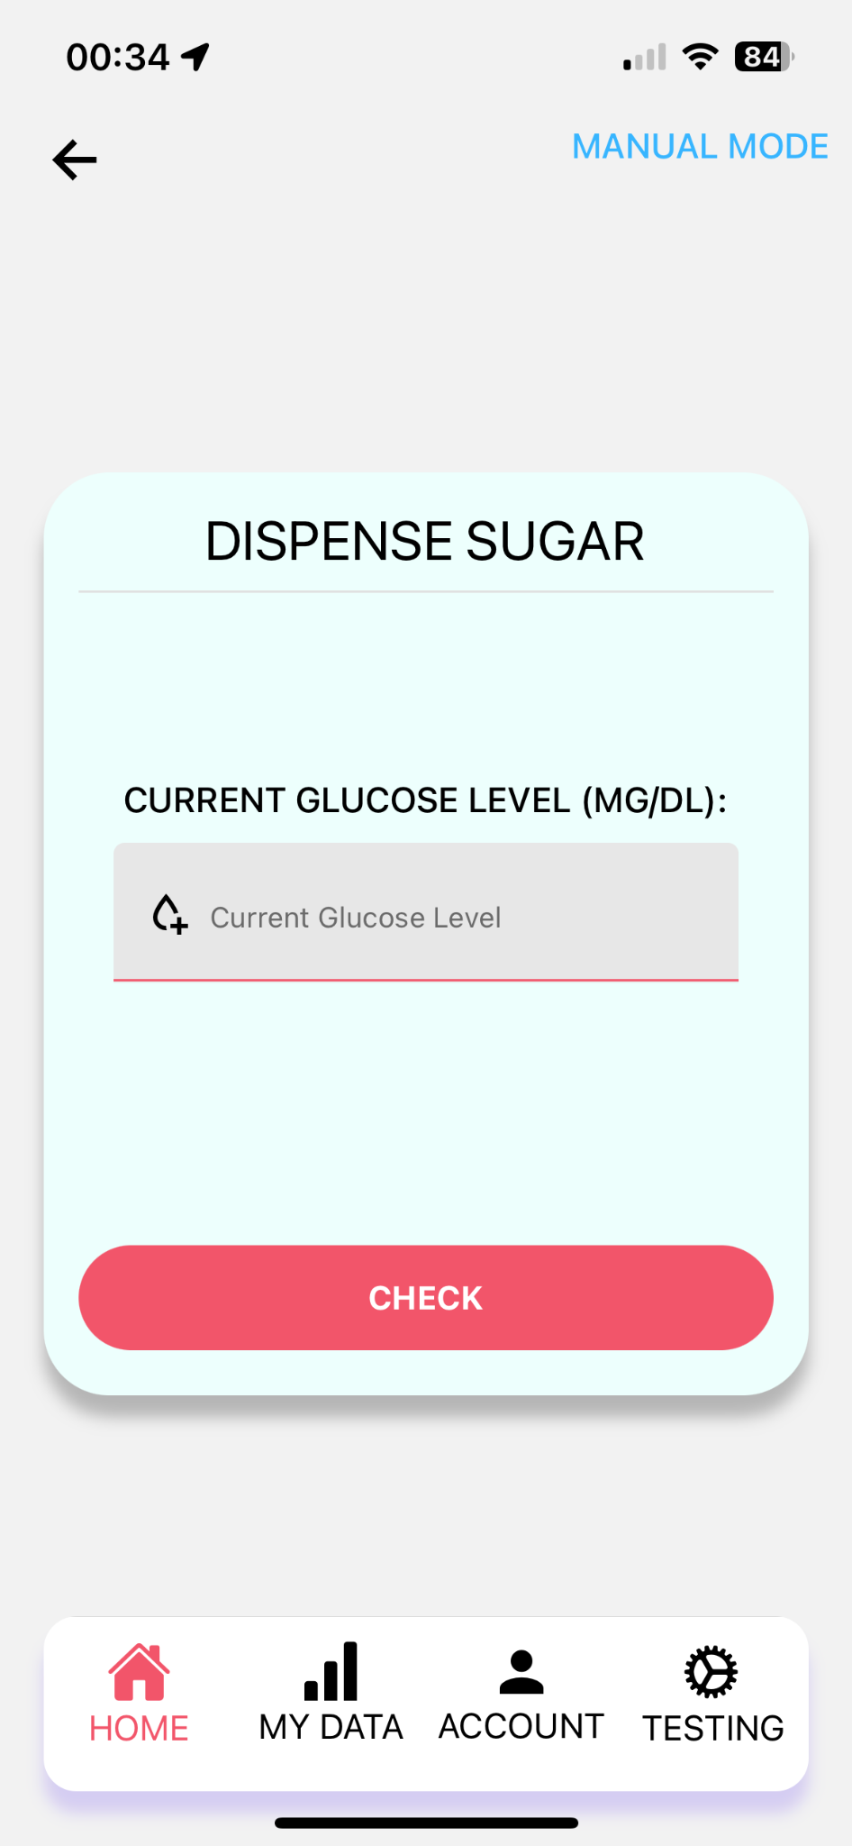
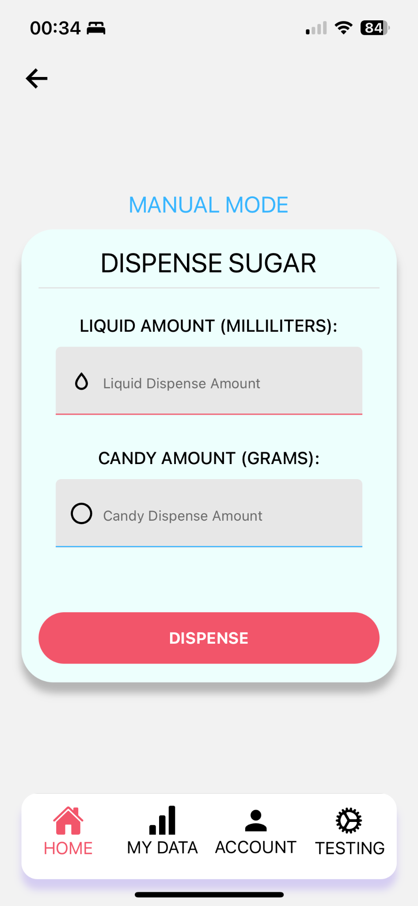
Application - Kelton Chesshire

Slide 11
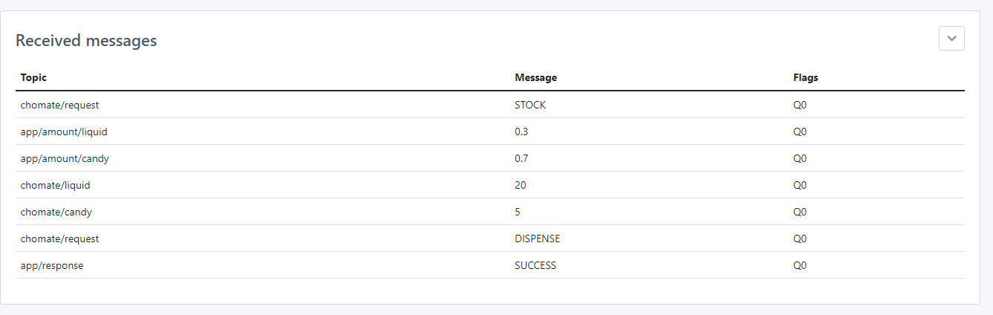
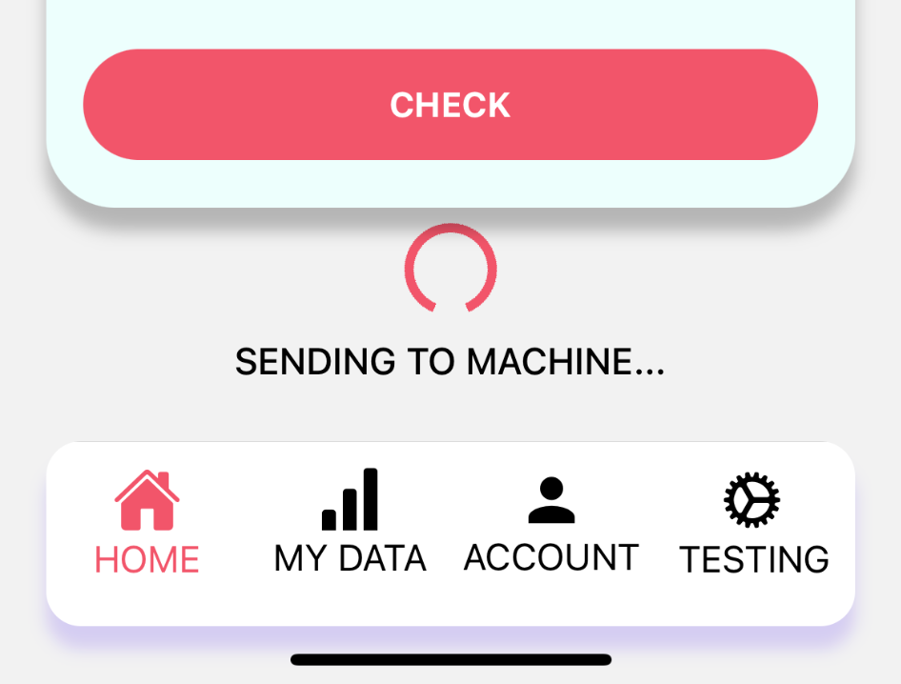
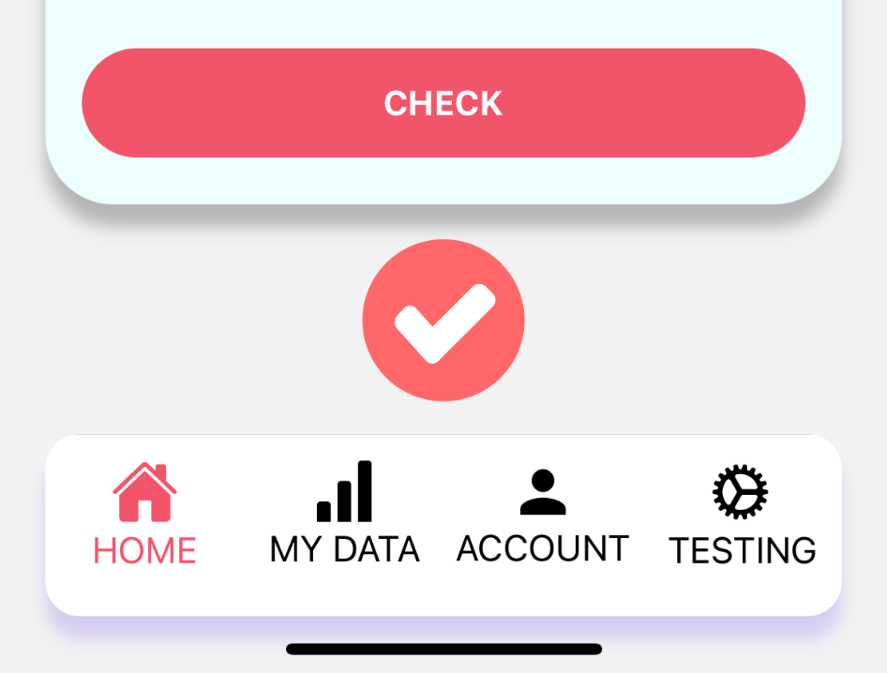
Application - Kelton Chesshire

Slide 12
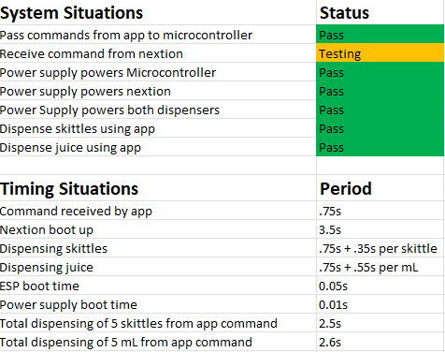
Integrated System Results

